Slide 1


Cyber Insurance Framework
Master Project - Mid-term Presentation
Viktor Matejka, Juan Huacan, Muriel Franco
Communication Systems Group CSG Department of Informatics IfI University of Zürich UZH
07/05/2021
Notes:
"It's scary and confusing...but at least it's boring..." CFO healthcare services provider, (Black Hat)

Slide 2
Table of Contents
Introduction
Related work
Project goals
Methodology
Framework
Next steps

Slide 3
INTRODUCTION

Slide 4
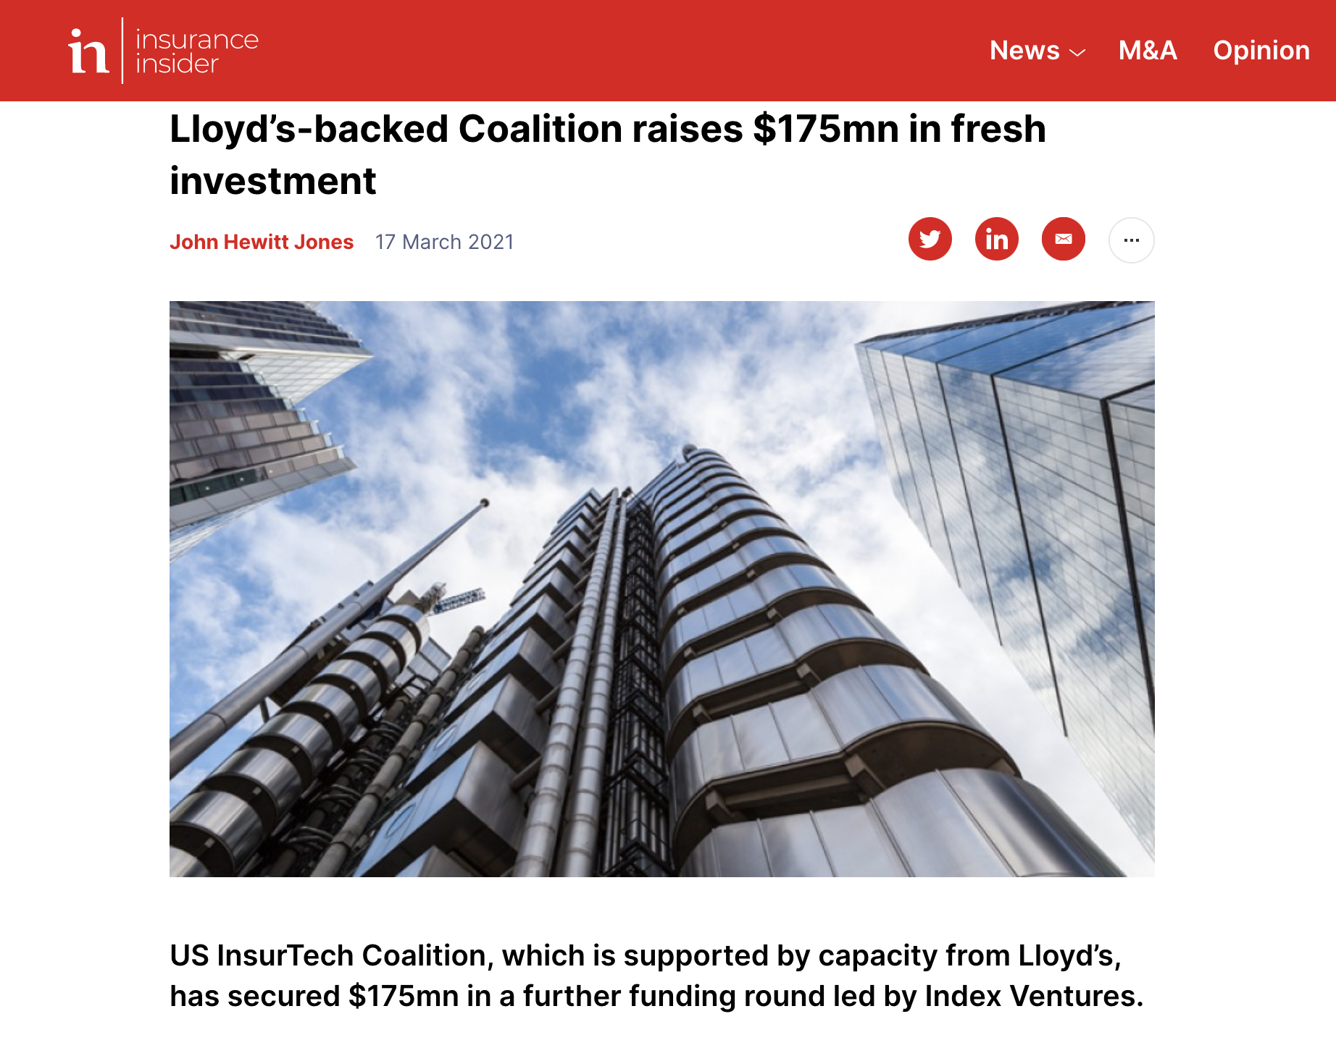
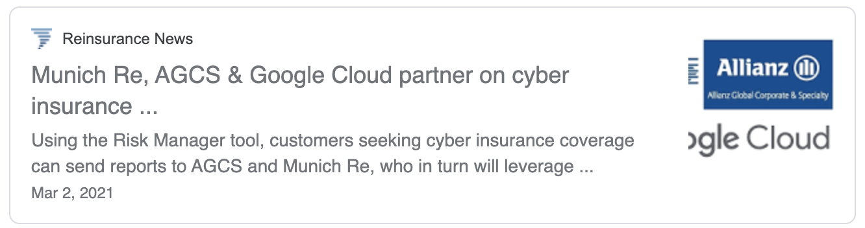
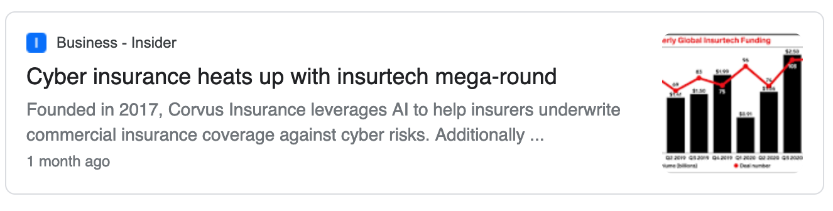
The good

Slide 5
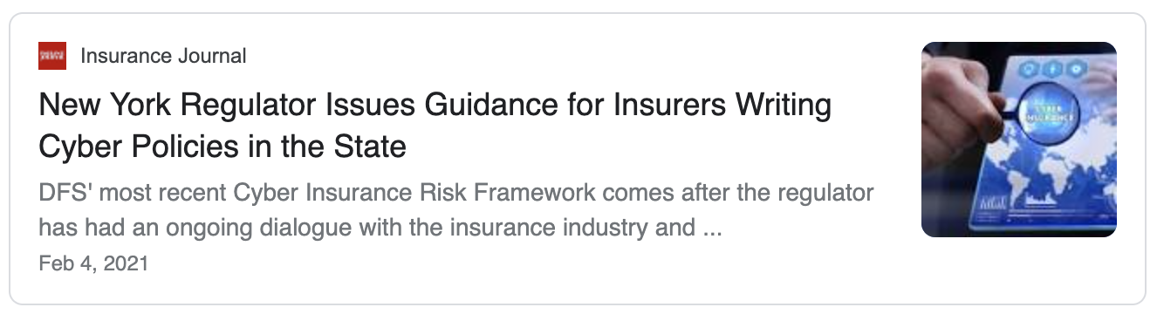
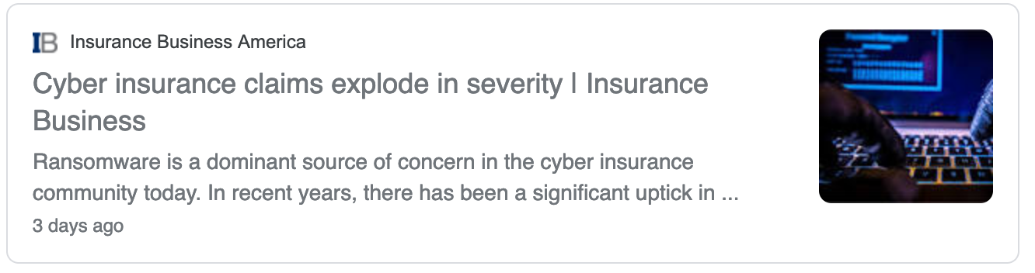
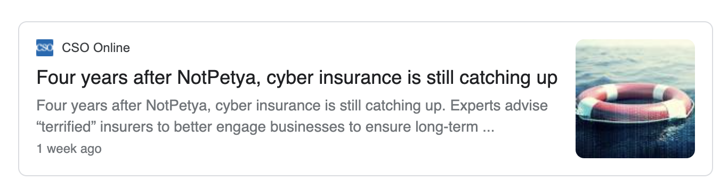
The bad
Notes:
add black hat quote

Slide 6
Introduction
Cyber insurance - form of risk transfer with a risk mitigation element
1997, to the first “internet security liability” policy (by AIG)
Munich Re estimates the Cyber Insurance (CI) market in 2020 at about US8−US9 billion in premiums
For context, in the US, CI premiums constitute <1% of all corporate insurance
CI market growth estimated at 21% p.a. (Infosecurity Magazine, 2021), compared to 4-5% of P&C as such (McKinsey, 2020)
Notes:
. Initially, CI policies were designed for information technology service providers rather than geared towards companies consuming such services.
business liability insurance, property insurance
Global Insurance Industry Insights - McKinsey
https://www.mckinsey.com › mckinsey › industries

Slide 7
Cyber Insurance 101 - contracts
“[In insurance], I’d rather have 10 lawyers for every statistician.” - Nassim Taleb
Cyber-insurance contract typically includes
Coverage, Rate schedule, Exclusions, Terms & conditions
Cyber insurance typically a mix of:
First party coverage (breach response, cyber crime, business interruption)
Third party coverage (privacy & security, regulatory, multimedia liability)
Services (vetted response & recovery)
IMPORTANT: (Damage to) Physical assets typically covered by other policies (excluded)

Slide 8
Cyber Insurance 101 - challenges
Key challenges:
Information Asymmetries:
Adverse Selection
Moral Hazard
Insurance Fraud
Interdependent Security (catastrophic scenarios)
Limited actuarial data (threat intelligence)
Cyber risks complex to model reliably
Heterogeneous market - many names and many different products
Key question → How can insurers measure risk, design contracts and set differentiated premiums?

Slide 9
PROJECT GOALS

Slide 10
Master Project Goals
Propose an actionable cyber insurance framework (roadmap) for insurance companies during the definition of a cyber insurance product:
Define requirements, steps, metrics, and actors
Include attributes, information required, and the process flow
Provide a review of actuarial models and approaches to calculate a fair premium for a given contract
Notes:
Evaluate the framework via case studies
Additional: integrate reinsurance aspects
WHAT

Slide 11
RELATED WORK

Slide 12
Related work (selection)
136 papers considered in total, 34 reviewed in detail, 9 key works selected
Notable (most cited): Böhme & Schwartz (2010), first unifying framework
Paper | Market / risk model | Economic Aspects / Challenges | Premium Calculation and Differentiation | Reinsurance Aspects | Organisational perspective | Process perspective
Gordon et al. (2003) | NO | Partially | NO | NO | Partially | Partially
Bandyopadhyay & Mookerjee (2019) | YES | Partially | YES | NO | NO | NO
Eling & Wirfs (2016) | YES | YES | YES | YES | NO | NO
Wang (2019) | YES | NO | YES | NO | Partially | Partially
Böhme & Schwartz (2010) | YES | YES | YES (limited) | NO | NO | NO
Böhme & Riek (2019) | YES | YES | YES (limited) | NO | NO | NO
Bandyopadhyay & Shidore (2011) | NO | NO | NO | NO | YES | NO
Rodrigues et al. (2019) | YES | YES | NO | NO | NO | NO
Kshetri (2020) | YES (institutional) | NO | NO | NO | Partially | Partially
This Master Project | YES | YES | YES | YES | YES | YES
Notes:
Take two or threee papers as highlight
Bandyopadhyay & Mookerjee (2019) - IT managers perspectiver
Wang (2019) - ptimal mix of cybersecurity investments in “knowledge and expertise” versus “deploying mitigation measures”
Rodrigues et al. (2019) - PMC RMC
Kshetri (2020) - INstitutioonal
Böhme & Schwartz (2010) - market model
Böhme & Riek (2019) - quantification

Slide 13
METHODOLOGY

Slide 14
Methodology
Literature Research
ER Model - Stakeholders
Process and
concept mapping
An exhaustive research was conducted. This first task was conducted following 3 sub-tasks: search, paper selection and analysis..
Different search methods were applied in this step such as “key words”, “related references”, etc.
The Entity-Relationship model shows us the interaction between the stakeholders along the whole cyber-insurance process.
The ER model helped us to draft a first picture of the framework.
Identification of different processes along the cyber-insurance model was also a crucial step to refine our proposed framework.
The processes were categorized in different level of granularities and this helped us to organized the framework in 3 different pillars.

Slide 15
Methodology - Literature Research
Analysis
The selected papers were studied to extract all the information about the current frameworks that exist already in the market. Our proposed framework was created from this source of information.
1
3
Paper selection
According to our project’s interests, approx. 34 papers were selected as part of our related work.
2
2
Search
Over 136 papers were found following different searching techniques. They are considered our source of information through all the present project.
1
3

Slide 16
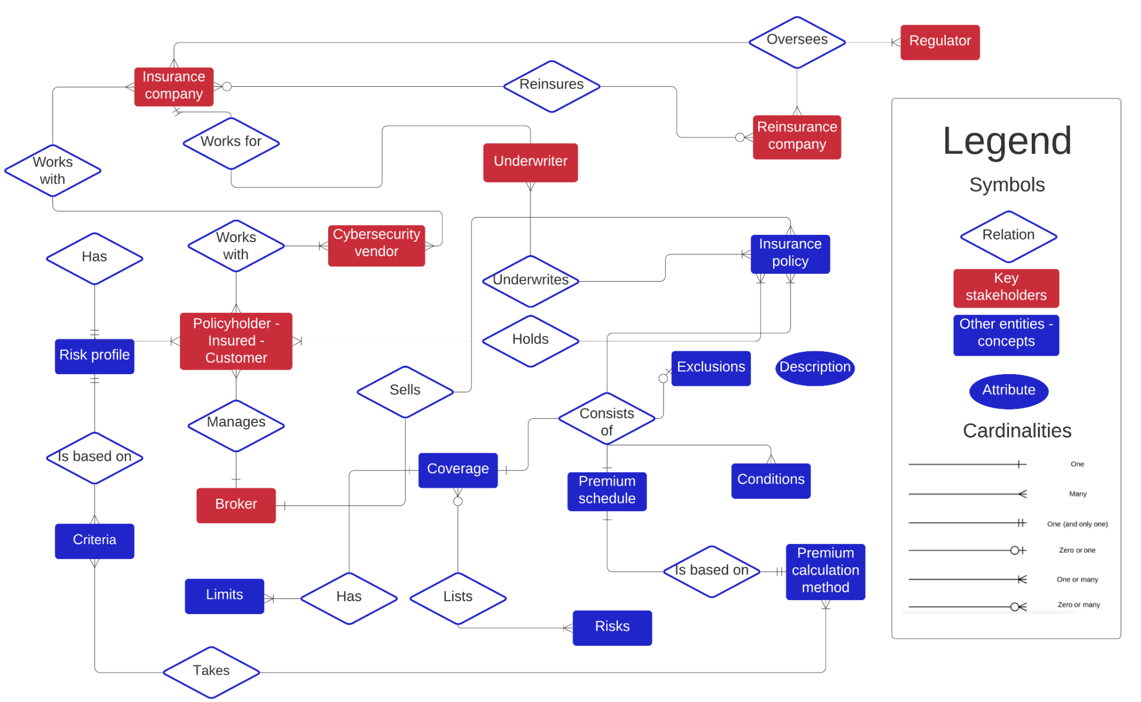
Methodology - ER Model of Stakeholders

Slide 17
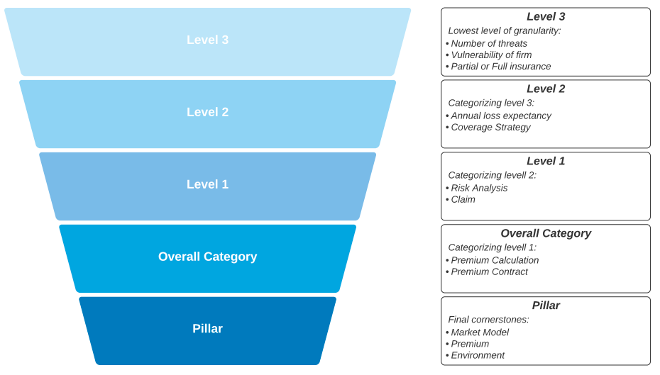
Methodology - Process and concept mapping

Slide 18
THE PROPOSED FRAMEWORK

Slide 19
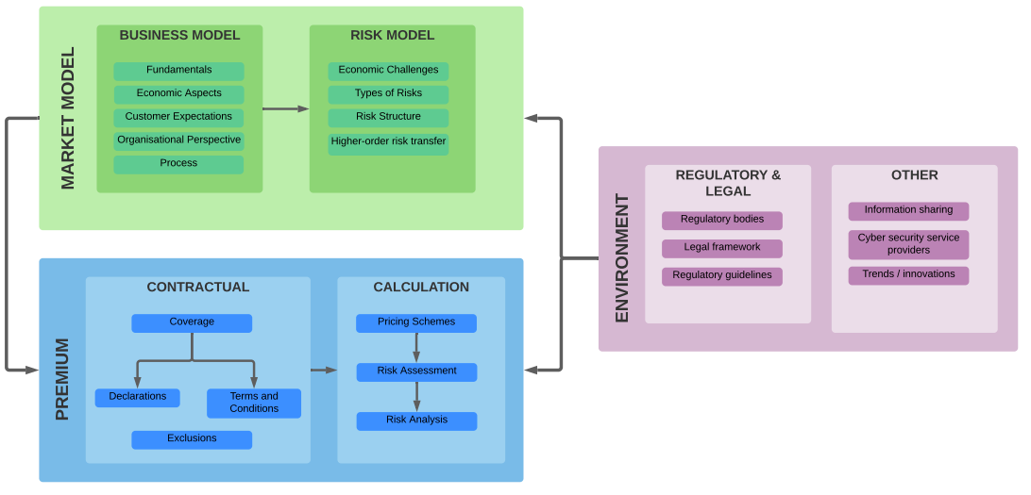
CI Framework - Overview

Slide 20
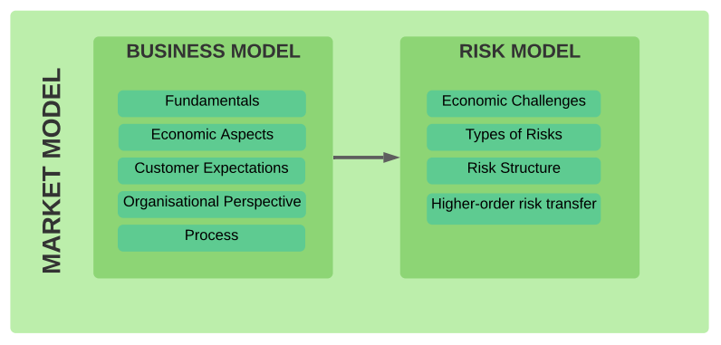
CI Framework - First Pillar

Slide 21
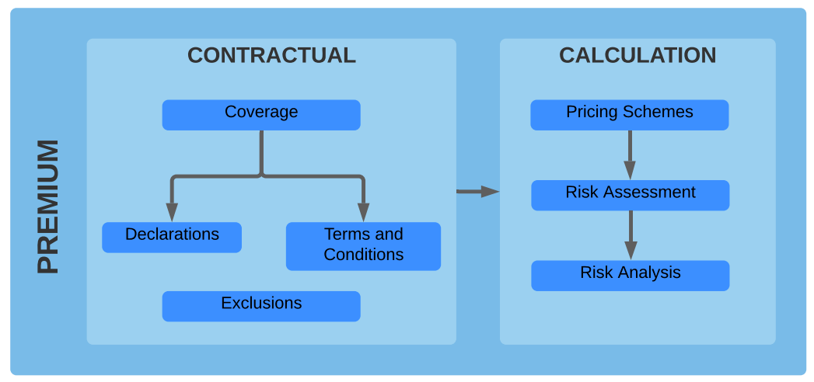
CI Framework - Second Pillar

Slide 22
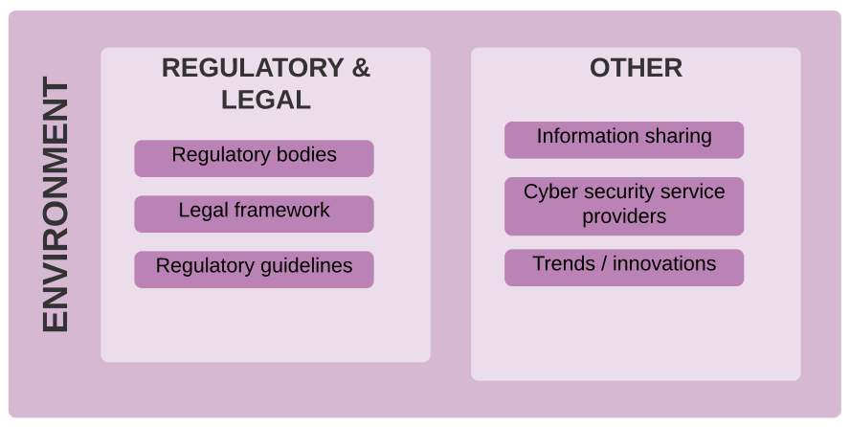
CI Framework - Third Pillar

Slide 23
NEXT STEPS

Slide 24
Next steps
Framework Refinement and Validation
Interviews with industry experts
Evaluation based on different Case Studies
Application of the framework to real-world scenarios (eCommerce, personal, financial services)
Survey of premium calculation methods / actuarial models
Continuation of the report

Slide 25
THANK YOU!

Slide 26
Q&A

Slide 27







Additional: Validation via Interviews
Survey design and goal setting underway
Target list done (focus on UZH alumni)
8 reinsurance, 9 insurance
Underwriters, cyber risk engineers, Cyber Insurance PMs
Key companies
Notes:
Move to Q and A

Slide 28
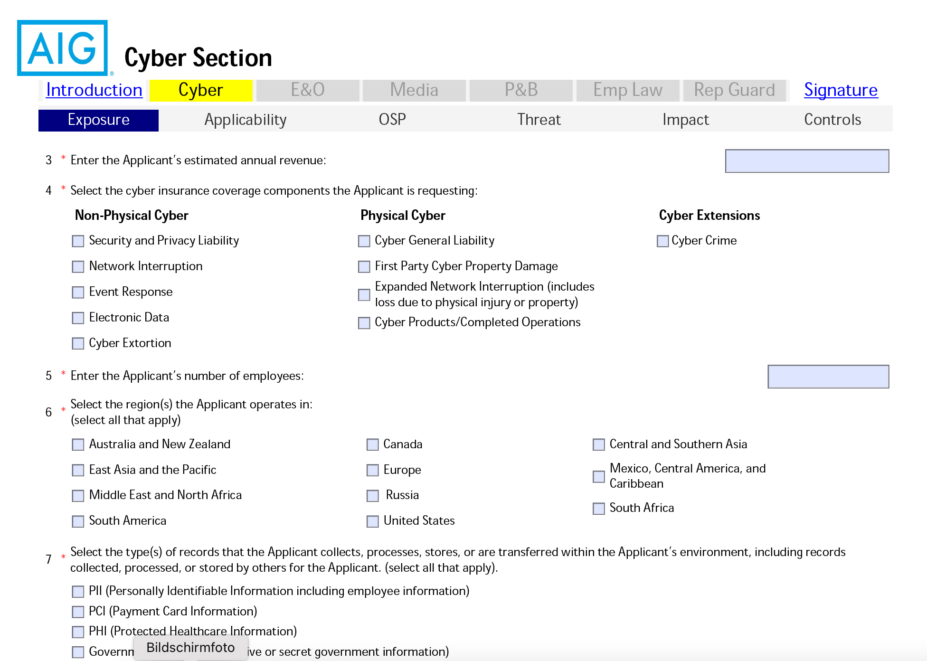
Excursion: Cyber Insurance application

Slide 29
CI Framework - First Pillar
BUSINESS MODEL
FUNDAMENTALS
ECONOMIC ASPECTS
CUSTOMER EXPECTATIONS
ORGANISATIONAL PERSPECTIVE
PROCESS
Fundamentals of insurance and reinsurance
Excursion of cybersecurity
Insurability criteria
Adjacent insurance policies.
Loss types
Quantification
Value added services
Market segment differences
ER Model
Institutions
Actors / Stakeholders
Go-to-market distribution
Underwriting process model

Slide 30
CI Framework - First Pillar
RISK MODEL
ECONOMIC CHALLENGES
TYPES OF RISK
RISK STRUCTURE
HIGHER-ORDER RISK TRANSFER
Asymmetric information
Adverse selection
Moral hazard
Correlated risk
Action of people
Systems and technology failures
Failed internal processes
External events
Parties
Layers
Model
Catastrophe boards
Exploit derivatives
Cyber reinsurance

Slide 31
CI Framework - Second Pillar
CALCULATION
PRICING SCHEMES
RISK ASSESSMENT
RISK ANALYSIS
Flat rate pricing
Base rate with modifications
Information security pricing
Alternative methods
Risk modeling
Security audit
Cyber security questionnaire
Underwriter discretion
Company-specific criteria
Organizational
Technical
Policies and procedures
Legal and compliance
Input: Risk assessment
Annual loss expectancy
Other considerations (TBD)

Slide 32
CI Framework - Second Pillar
CONTRACTUAL
COVERAGE
TERMS & CONDITIONS
EXCLUSIONS
Partial insurance
Full insurance
Loss types covered
Cover limits
Deductibles
Conditions
Co-payments
Typical exclusions
Other exclusions
Special cases
DECLARATIONS
Premium schedules

Slide 33
CI Framework - Third Pillar
REGULATORY & LEGAL
REGULATORY BODIES
REGULATORY GUIDELINES
LEGAL FRAMEWORK
EU: EIOPA, ENISA, EC
Excursion: Germany
Excursion: Switzerland
GDPR
Solvency II
EU NIS Directive
Legal considerations

Slide 34
CI Framework - Third Pillar
OTHER
INFORMATION SHARING
TRENDS / INNOVATIONS
CYBER SECURITY SERVICE PROVIDERS
CI data sources
Statistics, insurance tables
Self-service
External infrastructure scans
Parametric cyber insurance
Dynamic premiums
On-demand
Subscription models
Itemised insurance

